Slide 1
Olivet Discourse Part 2
Matthew 24:15-31

Slide 2
Introduction:
Two Questions:
When will the temple be destroyed?
What will be the sign of Jesus’ coming?

Slide 3
Introduction:

Slide 4
Introduction: Missional Focus
Matthew 24:14
¹⁴ This gospel of the kingdom shall be preached in the whole world as a testimony to all the nations, and then the end will come.

Slide 5
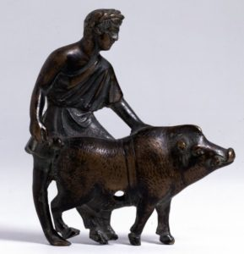
Great Tribulation (15-22):
Abomination of Desolation
Antiochus IV Epiphanes

Slide 6
Great Tribulation (15-22):
Matthew 24:22
²² Unless those days had been cut short, no life would have been saved; but for the sake of the elect those days will be cut short.
Expression of God’s grace and ultimate control

Slide 7
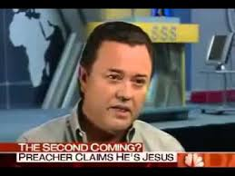
Discerning the Messiah (23-28):
Matthew 24:23
²³ Then if anyone says to you, ‘Behold, here is the Christ,’ or ‘There He is,’ do not believe him.

Slide 8
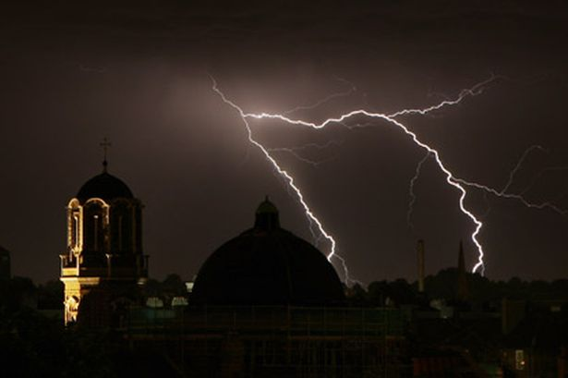
Discerning the Messiah (23-28):
Matthew 24:27
²⁷ For just as the lightning comes from the east and flashes even to the west, so will the coming of the Son of Man be.

Slide 9
Glorious Return (29-31):
Matthew 24:29-31
²⁹ “But immediately after the tribulation of those days the sun will be darkened, and the moon will not give its light, and the stars will fall from the sky, and the powers of the heavens will be shaken. ³⁰ And then the sign of the Son of Man will appear in the sky, and then all the tribes of the earth will mourn, and they will see the Son of Man coming on the clouds of the sky with power and great glory. ³¹ And He will send forth His angels with a great trumpet and they will gather together His elect from the four winds, from one end of the sky to the other.

Slide 10
Glorious Return (29-31):
Matthew 24:14
¹⁴ This gospel of the kingdom shall be preached in the whole world as a testimony to all the nations, and then the end will come.

