Slide 1
Jesus: The Incarnate Son

Slide 2
Introduction: The Incarnation
Do you know what I mean by that word, the Incarnation?

Slide 3
Introduction: The Incarnation
John 1:14 And the Word became flesh, and dwelt among us, and we saw His glory, glory as of the only begotten from the Father, full of grace and truth.
In the Incarnation,
Jesus is fully God and fully man

Slide 4
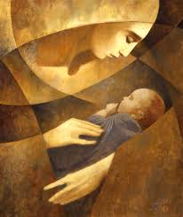
Theological Contemplations

Slide 5
Theological Contemplations

Slide 6
Theological Contemplations

Slide 7
Practical Reflections

Slide 8
Practical Reflections
Hebrews 2:17-18 “….. He had to be made like His brethren in all things …..

Slide 9
Practical Reflections
Where do you struggle to surrender to God’s will? To God’s Timing?
Jesus knows what that is like (Luke 22:42)

Slide 10
Practical Reflections
In the Incarnation, Jesus is fully God and fully man

